Slide 1


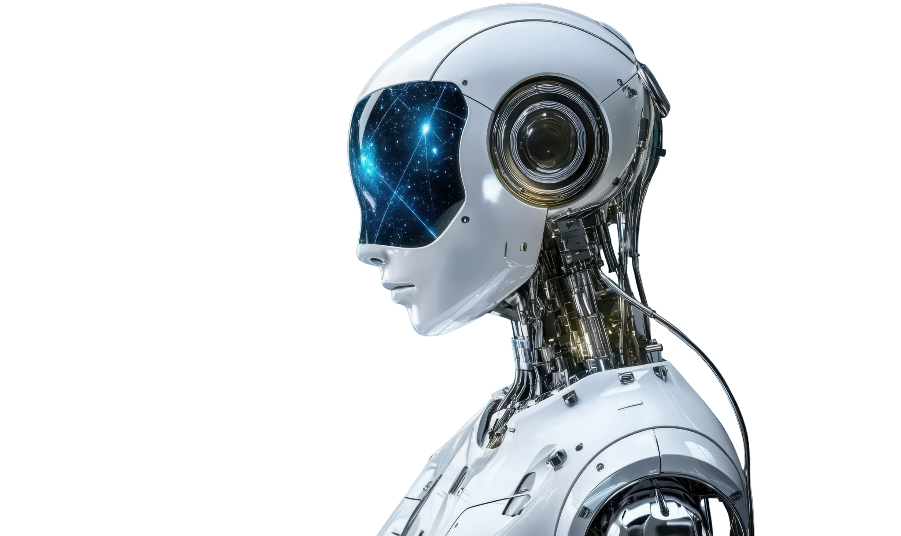


AGENTS
V/S
WORKFLOW

Slide 2

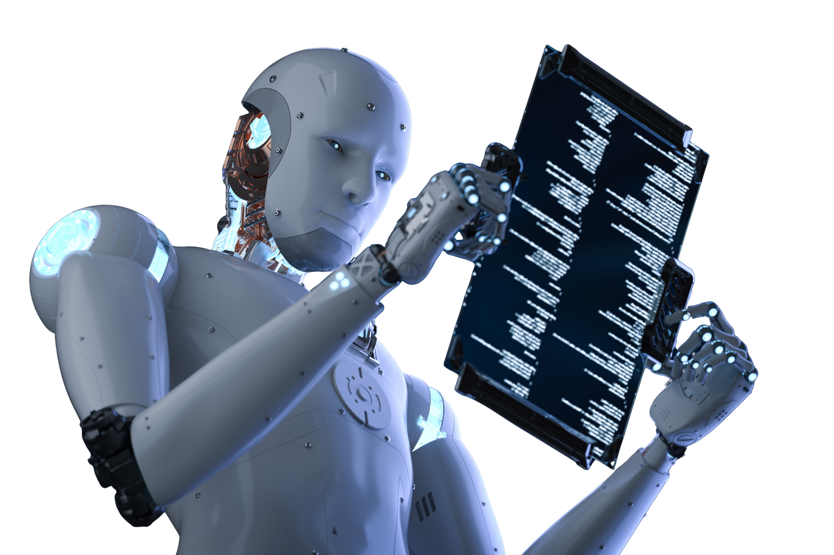
Workflow (Rule-based)
A workflow is a predefined sequence of steps executed in a fixed order.
THE SYSTEM DOES NOT THINK OR DECIDE, IT ONLY FOLLOWS INSTRUCTIONS.
👉 You already decide:
What steps happen
In what order
When the process ends

Slide 3
Agent (Autonomous )
An agent is an AI system that can:
Decide what to do next
Use tools
Reason about goals
Change its behavior based on context
👉 You give the agent a goal, not step-by-step instructions.

Slide 4

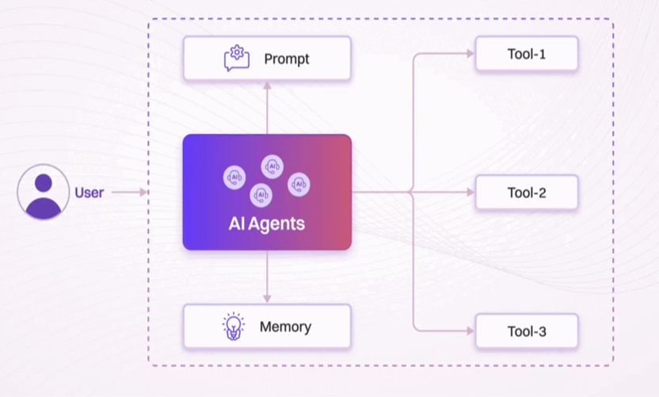
Single Agent
01
A single-agent system involves only one intelligent agent interacting with the environment to achieve its goal.
eg: Personal Assistant
Thynk Unlimited

Slide 5
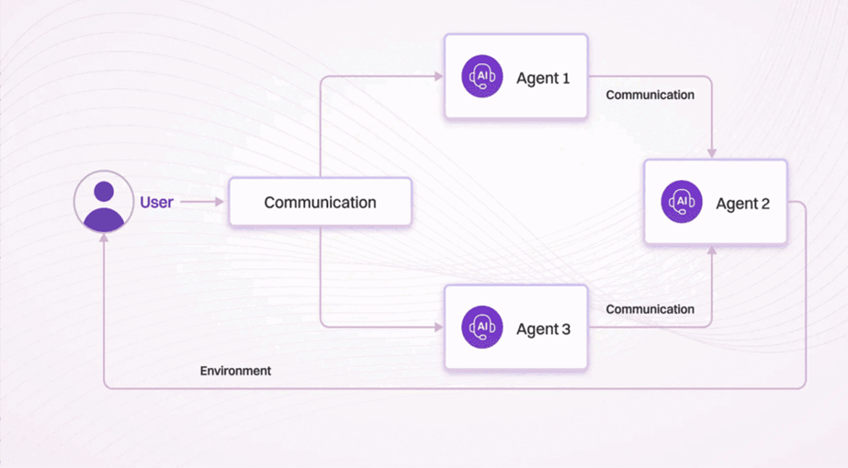
Multi Agent Systems
02
A multi-agent system involves two or more agents that interact, either cooperatively or competitively, within a shared environment.
eg: Resume Screening System.
Thynk Unlimited

Slide 6
How To Create AI Agents & Workflows
01
No-Code Platforms
02
code-based development

Slide 7
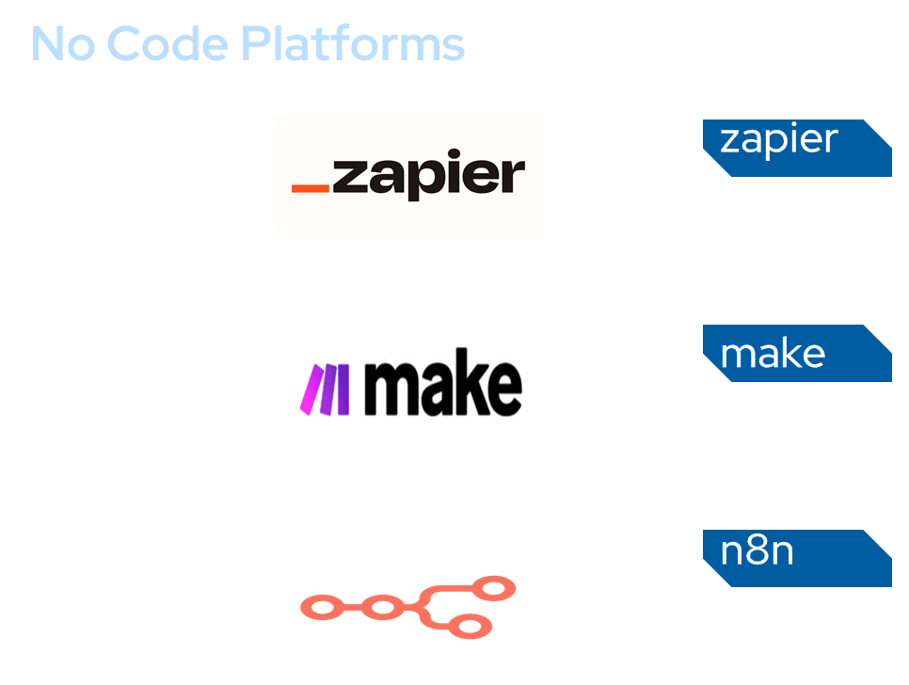

Slide 8




Using code

